Slide 1



AI-Led Finance Operations
From 80 Books to One View
September 2026
This communication is being sent by the offices of MindMap Digital Private Limited and is privileged, confidential and is directed to and for the use of the addressee only. If this message reaches anyone other than the intended recipient, we request the reader not to reproduce, copy, disseminate, or in any manner distribute it.

Slide 2









About Us
Our Presence
United Kingdom
IT transformed enterprises. AI will transform IT.
The next wave of enterprise value creation won't come from system integrators or legacy IT consultants; it will come from firms that understand both the art and science of AI-led transformation.
MindMap Digital is a niche, full-spectrum Enterprise AI Engineering firm one of the few globally that assesses, builds, deploys, and scales AI and automation across every business function.
We call it 360° AI Transformation.
United States
UAE & Middle East
India & APAC
Europe
Singapore
50+
100+
$100 Mn+
Enterprise Customers
AI Accelerators
Client savings delivered
In Progress

Slide 3



















Founding Team
Susheel Saboo — Co-Founder & Chairman
Saurabh Goenka — Co-Founder & CEO
Shilpa Saboo — Co-Founder & Interim CFO
60+ years of combined experience across enterprise technology, financial services, and global operations.
V
Saurabh Goenka
Susheel Saboo
Shilpa Saboo
Co-Founder & CEO
Co-Founder
Co-Founder
17+ years in digital transformation, ex-Wipro Technologies. CA turned technologist — speaks both the CFO's and CTO's language. Built MindMap's ROQS framework and 100+ AI accelerators from scratch. Forbes Business Council Advisor, ET 40 Under 40.
24+ years scaling global operations at Capital One and Genpact. MBA (Wake Forest), CA. Leads MindMap's acquisition strategy and enterprise growth — personally drove the BlueTide Analytics deal and North American expansion.
21+ years of global finance leadership at Capital One and Deloitte. CPA (USA) and CA. Architect of MindMap's profit-centric model that maintains 22-28% EBITDA margins while investing aggressively in growth.
V
Notes:
Please share a template: Attached

Slide 4

Our Solution
Unified Data Ingestion
Scheduled extraction from ~80 Tally instances, Wings, the OEM systems and Odoo, with no migration and no change at source.
Group Consolidation & Reporting
Monthly P&L, balance sheet, cash flow and ratios at group and entity level, with schedules generated and figures traceable to source records.
Canonical Data Layer
One spine for entity, branch, chart of accounts, counterparty, vehicle and part, carrying both mapping sets.
Exception & Case Management
Every failed check becomes a case with value, age, owner and proposed cause, chased to closure.
Finance Consolidation, Reconciliation & Assurance Platform
Reconciliation Engine
Interbranch, intercompany, OEM, GST and ledger reconciliations run as configuration rather than code, matched within set tolerances.
Controls & Assurance
Controls, delegations of authority and SOP limits configured once and tested continuously against every transaction.
Agentic Document Intelligence
OEM statements in the layouts they arrive in, PDF or Excel, read into structured lines, removing manual conversion before matching begins.
Treasury & Provisioning
Consolidated fund position, collections and payables due for working capital planning, with expected credit loss computed monthly rather than quarterly.

Slide 5



The Finance Cycle: Where It Breaks Down
Capture, close and reporting each hold one part of the picture, and no consolidated set of numbers exists between them.
1
2
3
Transaction Capture
Reconciliation
and Close
Reporting &
Control
Entries post into roughly 80 Tally instances with no consolidation between them
Every Maruti invoice is keyed twice, once in the DMS and once in Wings
Interbranch, intercompany, OEM and GST reconciliations are all worked by hand
Month end consolidation takes four to five days and produces P&L only, per entity
No group level monthly view, so treasury cannot forecast working capital
Controls are tested by hand against policy documents that differ by company

Slide 6


Current State
Close and reconciliation scale with the number of branches, not with the size of the business
What the platform changes
One canonical layer built from Tally, Wings, the OEM systems and Odoo
Every reconciliation runs as configuration, with only breaks reaching a person
Monthly group P&L, balance sheet and cash flow, traceable to the records received
Deploys alongside Tally, Wings and the OEM systems, with no migration
Where the effort goes
Group numbers rebuilt by hand from roughly 80 Tally instances each cycle
OEM statement reconciliation occupies one full time person every month
Inventory sits only in the OEM systems, never matched against billing

Slide 7
MM AgentVerse | Finance Agent Portfolio | Finance Operations · Control & Assurance
Receivables
Reconciliation
Consolidation
Invoicing & DMS
Inventory & Margin
Intercompany
Treasury & P2P
Controls & MIS
★ Featured
FINANCE OPERATIONS | 18 Agents
CONTROL & ASSURANCE | 18 Agents
F01
★
F02
★
F03
★
F04
F05
F06
F07
★
F08
★
F09
Tc
Wc
De
Oc
Lm
Ir
Dl
Cm
Mg
Tally Collector
Wings Connector
DMS Extractor
Odoo Connector
Ledger Mapper
Identity Resolver
Debtor Ledger Agent
Collection Matcher
MPR Generator
Scheduled extraction from every branch Tally instance across the group. Runs by central pull, site collector or file export, with one output contract whichever route is used.
Reads the PVSL books from Wings on the same schedule as Tally, by read-only database access, replica or scheduled report, with one output contract whichever route is used.
Pulls billing, stock and statement data from each OEM dealer management system, by interface where one exists and by report extract where it does not.
Brings vendor records, requests for quotation and purchase orders out of Odoo, giving procurement its first link to the accounting layer.
Maps every branch ledger onto the canonical chart of accounts, carrying the MIS and statutory views in parallel and proposing new mappings for approval.
Resolves branch codes, party names, vehicle references and document numbers into one canonical identity, so matching can run across systems.
Maintains one group wide receivables position from all branch books, so the debtors summary and its ledger detail are produced on demand instead of rebuilt.
Knocks off collections against open invoices on reference first, then on amount, party and date within tolerance. Only unmatched items reach a person.
Produces the monthly performance report from the MIS mapping set on a schedule, replacing the branch by branch download and manual assembly.
F10
F11
★
F12
F13
F14
F15
F16
★
F17
F18
Ib
Ic
Os
Or
Op
Gr
Lr
Pv
Ce
Interbranch Matcher
Intercompany Matcher
OEM Statement Reader
OEM Recon Agent
OEM Provision Tracker
GST Reconciler
Ledger Reconciler
Provision Reversal Agent
Consolidation Engine
Pairs both sides of every branch to branch transaction on ledger, amount, date and reference, so the counterparty check no longer means opening each book.
Matches related party transactions between group companies automatically, using the related party flag held on the counterparty master.
Reads OEM statements in any layout, PDF or Excel, into structured lines, removing the manual conversion step before any matching can begin.
Matches the OEM statement against the group's own statement of account line by line, then routes each break with a proposed cause and its evidence.
Tracks provision aging against the invoicing raised and ages the gap between them, a position with no equivalent in the current process.
Reconciles returns and forms against the books as a configured rule set, so the position is visible through the month rather than at the due date.
Runs general ledger, trial balance and statutory against books reconciliations from one spine, each defined as a configuration object.
Tracks every provision against its expected reversal and raises the missing one with the entry pre built, removing the duplicate expense exposure.
Rolls up branch to entity to holding company across both mapping sets, with interbranch and intercompany balances eliminated by rule before roll up.
C01
★
C02
★
C03
C04
C05
C06
★
C07
C08
C09
★
Sb
Sg
Ra
Db
If
Ai
Sv
Ma
Dm
Schedule Builder
Statement Generator
Ratio Analyst
DMS Billing Reconciler
Invoice Filter Agent
Auto Invoicing Agent
Stock Variance Agent
Margin Analyst
Discount Monitor
Generates the financial schedules for every location including PVSL, from templates defined once against the statutory mapping set.
Produces monthly profit and loss, balance sheet and cash flow at group and entity level, with figures traceable to the branch records received.
Derives the ratio pack from the consolidated statements, extending monthly reporting past the profit and loss view that exists today.
Reconciles billing raised in each OEM system against the books as a configured reconciliation, replacing the manual brand by brand check.
Applies the rule that decides which DMS invoices belong in the group ERP, holding that rule as an explicit and versioned artefact.
Transforms DMS invoice data into the ERP posting format so the second manual entry is generated rather than keyed. Stock stays outside the interface.
Compares uploaded counts, DMS stock and the books against the vehicle and part masters, raising every variance as a case ranked by value.
Derives margin by vehicle, location and variant across sales, parts, accessories, lubricants and tyres, where the DMS carries vehicle cost.
Derives discount per transaction and tests it against authority thresholds, turning a spreadsheet filtering exercise into a standing control.
C10
★
C11
C12
★
C13
C14
C15
C16
C17
C18
★
Sa
Rl
Ca
Tv
Pa
Ec
Ct
Ls
Mn
Spares Aging Agent
RPT Limit Tracker
Charge Allocator
Treasury View Agent
Payables Aging Agent
ECL Engine
Control Testing Agent
Ledger Scrutiny Agent
MIS Narrative Agent
Computes spares aging from part movement history and flags non moving parts, replacing the manual summary for the Tally entities.
Accumulates related party consumption against the board limit, pro rates it to year end and alerts before the limit is reached rather than after.
Recalculates the corporate and head office allocation each period from current cost data and reports drift against the approved basis.
Brings fund position, collections and payables due into one refreshed view, so the payment cycle and working capital can be forecast.
Ages payables from matched purchase orders, receipts and invoices, supplying the position treasury cannot obtain from the systems today.
Computes expected credit loss monthly from receivables aging against a configurable bucket matrix, with scenarios modelled rather than adjusted by hand.
Tests controls, delegations of authority and standard operating limits continuously against full population rather than by sample.
Runs a master of recurring findings across the general ledger and raises each match as an exception item with the evidence attached.
Drafts the investor and debt reporting commentary and flags source data anomalies before the pack is built, addressing the oversight risk.
36
2
8
14
18
18
Total Agents
Finance Domains
Sub-Domains
Featured ★
Finance Operations
Control & Assurance

Slide 8

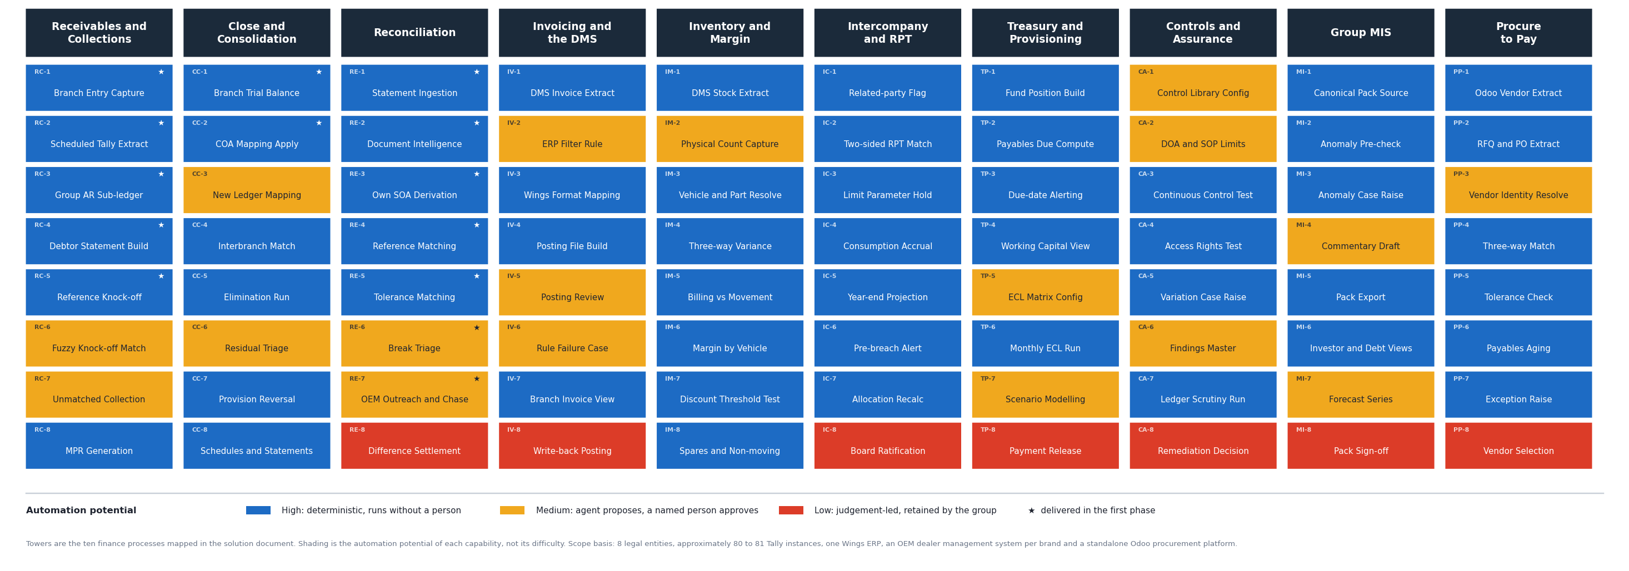
Solution Heat Map | Ten Towers, Eighty Capabilities

Slide 9









Mindmap Digital | Finance Consolidation Platform
Process 1 | Receivables and Collections
Mmindmapai
Every receivables answer begins by opening each branch book in turn, so the debtors position is rebuilt from source each cycle.
Collections matching depends on the same extraction, which makes it continuous rather than periodic.
Branch Instances
Invoice Matching
80
Manual
Receivables Today
Receivables Today
Branch Posting
Instance by Instance Extraction
1
Post entries in Tally
• Entries posted in Tally at each branch and location
• Roughly 80 separate instances across the group
• No consolidation held between any two instances
• Every group answer starts from these books
• Each instance opened and extracted in turn
• Repeated for every instance, every cycle
• Output copied into Excel by hand
• Transcription risk at each of the 81 steps
2
Open each instance
3
Extract data
Debtor Summary Assembly
Collection Knock-off
4
Paste into Excel
• Consolidated debtors summary built manually
• Supporting ledger detail assembled alongside
• Time consuming and repeated every cycle
• No drill back to the originating voucher
• Credit sales make matching continuous
• Each collection matched invoice by invoice
• Every invoice adjusted individually
• Depends on the same instance by instance extraction
5
Assemble summary
6
Match collections
Monthly Reporting
What It Costs
• Branch databases downloaded one at a time
• Consolidated by hand into the MPR
• Mapped against the chart of accounts
• Mapping differs from entity to entity
• 81 manual system extracts every cycle
• Debtors position never current between cycles
• Collections effort scales with branch count
• No single receivables view at any point

Slide 10
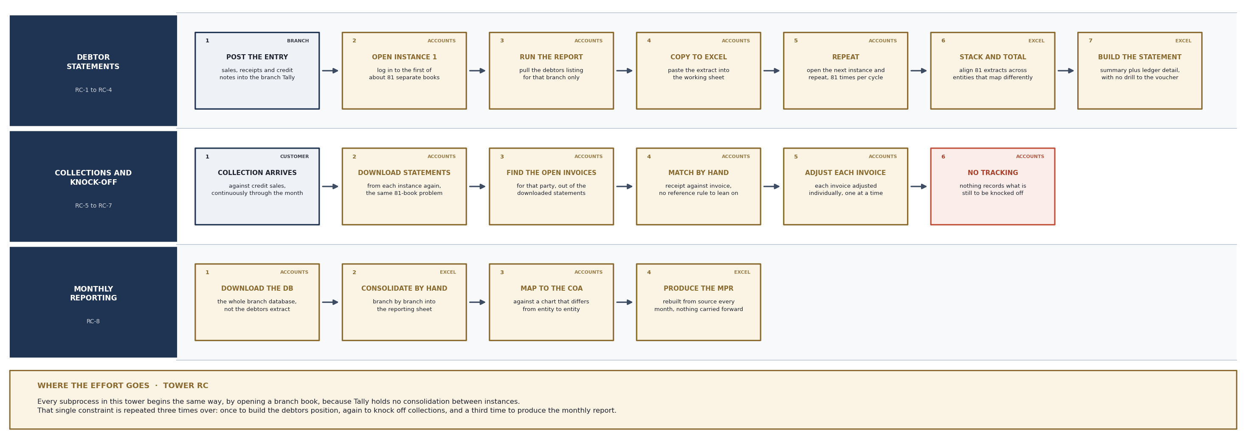
Current Process | Tower RC · Receivables and Collections

Slide 11
Mindmap Digital | Finance Consolidation Platform
Process 1 | Receivables on the Platform
Mmindmapai
The branch books stay as they are. The platform extracts them on a schedule into one group-wide receivables ledger.
Matching runs against that ledger, so only collections that fail to match reach a person.
Manual Extracts
Debtors Position
Zero
Current
Receivables on the Platform
Receivables on the Platform
Scheduled Extraction
One Group Ledger
1
Scheduled extract
• Entries posted in Tally exactly as today
• Connector tier pulls every instance on a schedule
• Central pull, site collector or file drop
• No human step between branch and platform
• Entries resolve into one receivables sub-ledger
• Entity, branch and party under canonical codes
• Aging maintained continuously, not rebuilt
• One debtors position instead of 81 partial ones
2
Canonical ledger
3
Aging maintained
Statements on Demand
Automatic Knock-off
4
Auto knock-off
• Debtors summary produced as a query
• Supporting ledger detail generated with it
• Any figure traces back to the source record
• Verifiable without opening Tally
• Matched on document reference first
• Identity agent resolves party and reference variants
• Amount, party and date matched within tolerance
• Coverage rises as the reference map improves
5
Exceptions only
6
Report generated
Reporting Generated
What Changes
• MPR built from data already in the platform
• MIS mapping applied once, consistently
• Mapping agent proposes new ledgers for approval
• Produced on a schedule rather than assembled
• The rebuild each cycle disappears
• Effort stops scaling with branch count
• The team works breaks, not the whole population
• Receivables visible at any point in the month

Slide 12
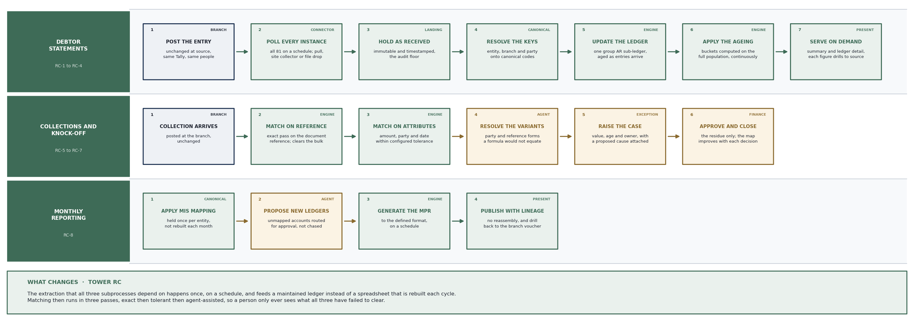
Target Process | Tower RC · Receivables and Collections

Slide 13
Mindmap Digital | Finance Consolidation Platform
Process 2 | Month-end Close
Mmindmapai
Each of the eight companies consolidates its own branches by hand.
The eight sets are then consolidated again for the holding company.
Close Effort
Full Financials
4-5d
4 a Year
Close and Consolidation Today
Close and Consolidation Today
Branch Extraction
Two Stage Consolidation
1
Extract branches
• Branch books extracted from each instance
• Manual, repeated for every branch
• Consolidation begins with extraction
• Nothing is held between cycles
• Each company consolidates its own branches
• Each produces one set of financials
• The eight sets consolidate at holding level
• Both stages performed by hand
2
Consolidate entity
3
Consolidate group
Interbranch Elimination
Provision Reversal
4
Eliminate by hand
• Interbranch and intercompany balances removed
• The majority of the four to five day effort
• Each instance opened to check the other side
• Reconciling entries posted manually
• Provisions booked monthly in Tally
• Reversal the following month depends on recall
• When missed, the invoice is booked as well
• Expense is duplicated in the books
5
Monthly P and L
6
Quarterly full set
Financial Schedules
What It Costs
• Prepared by hand for all locations
• Wings does not generate them for PVSL
• Coverage is inconsistent across the group
• Consolidated manually after preparation
• Four to five days of a controller each month
• Monthly output is P and L only, per entity
• No balance sheet or cash flow at group level
• The full view exists four times a year

Slide 14
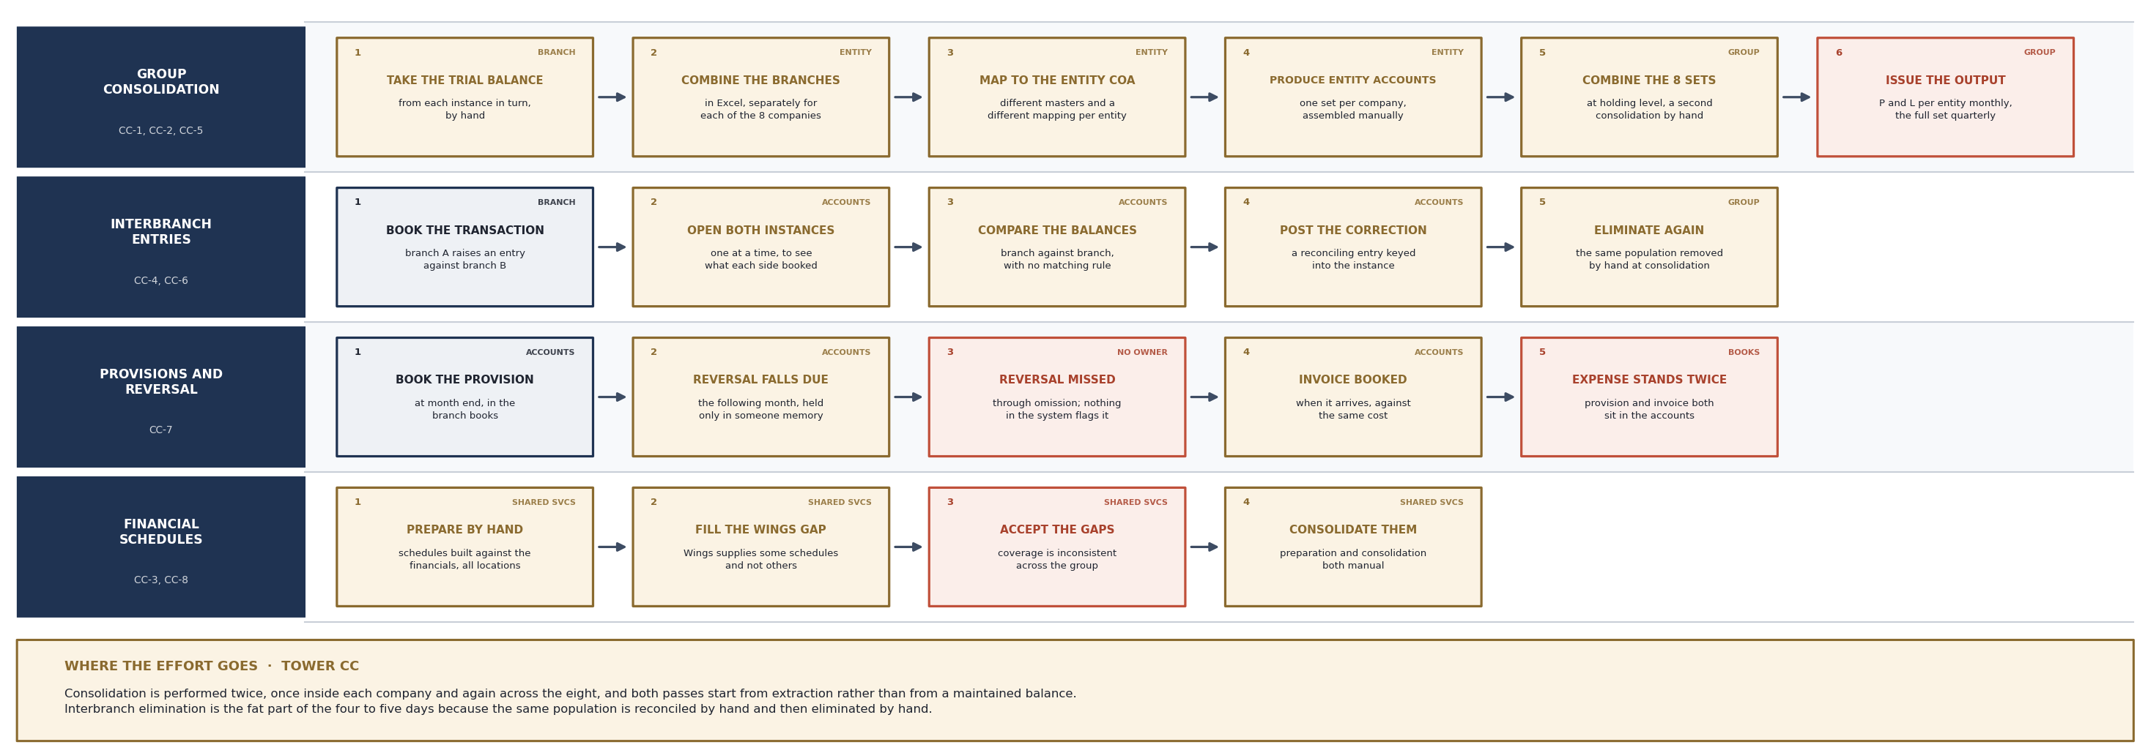
Current Process | Tower CC · Close and Consolidation

Slide 15
Mindmap Digital | Finance Consolidation Platform
Process 2 | Close on the Platform
Mmindmapai
A trial balance per branch is maintained continuously from the scheduled extract.
Elimination runs by rule, so the controller reviews residuals instead of building.
Elimination
Group View
Rule
Monthly
Close on the Platform
Close on the Platform
Continuous Trial Balance
Rule Based Elimination
1
Continuous TB
• Branch trial balance maintained from the extract
• Consolidation no longer starts with extraction
• The position is current between cycles
• No download step at the close
• Interbranch pairs matched on ledger and reference
• Amount and date matched within tolerance
• Elimination applied from the matched population
• Removes the largest part of the close
2
Match interbranch
3
Eliminate by rule
Residuals Reviewed
Provision Tracking
4
Review residuals
• Each residual carries a proposed cause
• Evidence is attached to the case
• Ranked by value and age
• The controller reviews rather than investigates
• Every provision tracked to its expected reversal
• A missing reversal is detected the next period
• The case is raised with the entry pre-built
• Posted under maker-checker in a later phase
5
Roll up to group
6
Full statement set
Schedules Generated
What Changes
• Templates defined once against statutory mapping
• Generated for every location including PVSL
• Supporting notes drafted for review
• Consolidated and exported with drill-down
• Roll-up runs branch to entity to holding
• Both mapping sets carried in parallel
• Monthly P and L, balance sheet and cash flow
• Every figure traces to the source record

Slide 16
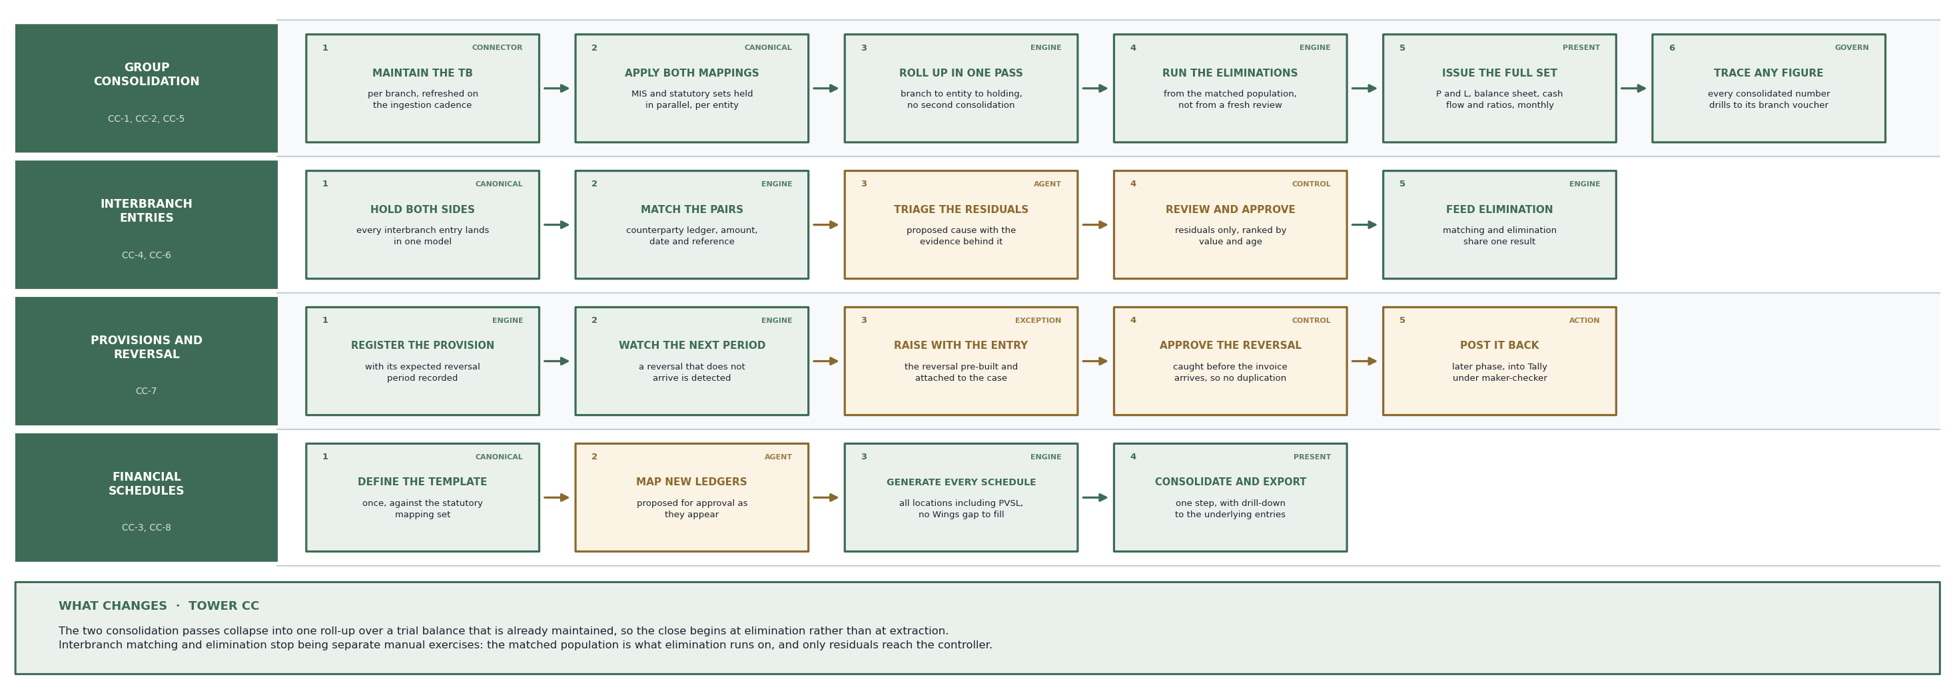
Target Process | Tower CC · Close and Consolidation

Slide 17
Mindmap Digital | Finance Consolidation Platform
Process 3 | Reconciliation
Mmindmapai
Reconciliation is performed by hand across four separate disciplines.
OEM statement reconciliation alone occupies one dedicated resource permanently.
OEM Recon
GST Effort
1 FTE
1-1.5d
Reconciliation Today
Reconciliation Today
OEM Statements Collected
Manual PDF Conversion
1
Collect statements
• Statements arrive as Excel files or PDFs
• Format varies from OEM to OEM
• Collected manually each month
• Two reconciliation types run in parallel
• Every PDF statement converted to Excel by hand
• Repeated for each statement, each cycle
• Transcription risk at every conversion
• Pure preparation before any matching starts
2
Convert PDFs by hand
3
Draw own statement
Line by Line Comparison
GST and Statutory
4
Compare in Excel
• The own statement drawn from the books manually
• The two sides compared through Excel formulas
• Differences identified line against line
• Follow-up to the OEM depends on memory
• Reconciliations run between returns and forms
• In-house Excel templates already optimised once
• One to one and a half days per person
• Work runs to the due date where needed
5
Work differences
6
Chase the OEM
GL and Trial Balance
What It Costs
• General ledger reconciliation performed manually
• Trial balance checked by hand
• Statutory position compared against the books
• No supporting tooling in place
• One exclusive full-time resource, permanently
• Deadline compression every month end
• No reconciliation is configurable today
• Each new reconciliation is built from scratch

Slide 18
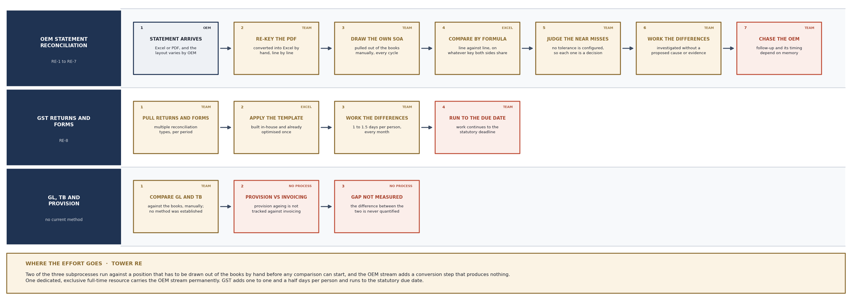
Current Process | Tower RE · Reconciliation

Slide 19
Mindmap Digital | Finance Consolidation Platform
Process 3 | Reconciliation Engine
Mmindmapai
Every reconciliation becomes a configuration object on one engine.
Agents read the statements, resolve identity, triage breaks and chase replies.
Engines
New Recons
One
Config
Reconciliation on the Platform
Reconciliation on the Platform
Statements As Received
Document Intelligence
1
Ingest as received
• Statements ingested in whatever format they arrive
• No format preparation before loading
• Held as received in the landing store
• The audit floor for every match
• Any layout read into structured lines
• The manual conversion step disappears
• Works across PDF and Excel alike
• Output feeds matching directly
2
Read to structure
3
Derive own statement
Rule Based Matching
Break Triage
4
Match on rules
• The own statement derived from the books
• Lines matched on reference first
• Then on attributes within tolerance
• Formula comparison replaced by a rule set
• Each break carries a proposed cause
• An evidence pack is attached
• Ranked by value and age
• Investigation becomes review
5
Triage the breaks
6
Chase and close
Automated Outreach
What Changes
• The chase to the OEM is drafted for approval
• Tracked against an SLA and chased
• Follow-up stops depending on memory
• A named person approves, sends and closes
• GST position visible through the month
• Provision aged against invoicing, a new capability
• New reconciliations configured, not coded
• Left source, right source, key, tolerance, routing

Slide 20
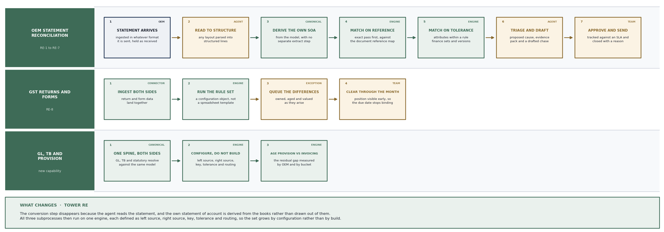
Target Process | Tower RE · Reconciliation

Slide 21
Mindmap Digital | Finance Consolidation Platform
Process 4 | Invoicing and the DMS
Mmindmapai
Maruti shares very limited interfaces with the group ERP.
Every sales and service invoice at a Maruti location is posted twice by hand.
Maruti Entry
Filter Rule
Twice
None
Invoicing Today
Invoicing Today
Posting into the DMS
Posting Again into Wings
1
Sale or service job
• A sale, service job or workshop invoice occurs
• The entry is posted into the Maruti DMS
• Required by the OEM
• This posting is not optional
• The same entry is posted into the group ERP
• No data flows between the two systems
• Both postings made by hand
• Double the accounting time per invoice
2
Post into the DMS
3
Post into Wings
Every Maruti Location
Decentralised Invoicing
4
Repeat per invoice
• The pattern repeats at every location
• Effort scales with volume and site count
• Accounting manpower carried at each site
• No central posting point exists
• Invoicing raised at each branch for sales
• And for services, separately
• Spread across six to seven states
• Each branch carries its own manpower
5
Repeat per location
6
No central view
No Filter Rule
What It Costs
• A large volume of invoices raised in the DMS
• Not all of them belong in the group ERP
• Which ones do is not defined as a rule
• This blocks any straight-through push
• Every Maruti invoice accounted twice
• Manpower distributed across every site
• No single view of branch invoicing
• Integration blocked by the missing rule

Slide 22
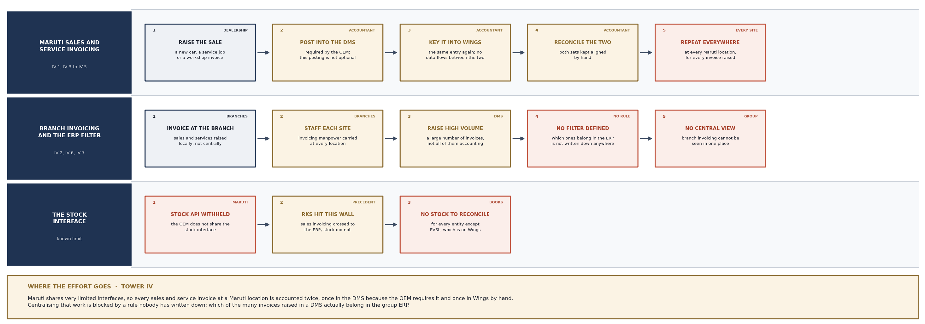
Current Process | Tower IV · Invoicing and the DMS

Slide 23
Mindmap Digital | Finance Consolidation Platform
Process 4 | One Posting, Not Two
Mmindmapai
The DMS posting stays exactly as the OEM requires it.
The second entry is generated from the first rather than typed again.
Manual Entry
Filter Rule
One
Owned
Invoicing on the Platform
Invoicing on the Platform
DMS Posting Unchanged
Scheduled Extraction
1
Post in DMS once
• The entry is posted into the DMS once
• The OEM requirement is unaffected
• No change asked of the dealership
• Nothing is migrated
• DMS invoice data extracted on a schedule
• Report extract where no interface exists
• The second manual entry stops being the source
• Held as received before any transformation
2
Extract on schedule
3
Apply filter rule
Configurable Filter
Transformation Once
4
Transform to Wings
• A rule set decides which invoices reach the ERP
• Defined and versioned by finance
• The missing rule becomes a maintained artefact
• Failing invoices are raised, not dropped
• Selected invoices mapped to the Wings format
• The transformation is defined a single time
• Applied consistently at every location
• Errors surface as cases, not as silence
5
Reviewed import file
6
Write-back later
Phased Write-back
The Known Limit
• Phase one produces a reviewed posting file
• No write access needed in phase one
• Phase two posts directly under maker-checker
• Supports the central manpower objective
• Stock does not flow through this interface
• Maruti stock is not shared by the OEM
• Invoicing can be carried across, stock cannot
• Inventory is addressed by a different route

Slide 24
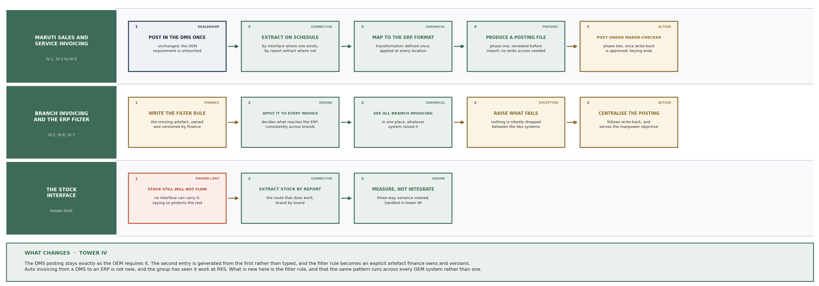
Target Process | Tower IV · Invoicing and the DMS

Slide 25
Mindmap Digital | Finance Consolidation Platform
Process 5 | Inventory and Margin
Mmindmapai
Inventory for every entity except PVSL exists only in the OEM system.
There is no stock record in the group books to reconcile it against.
Stock in Books
Margin Work
PVSL
Manual
Inventory and Margin Today
Inventory and Margin Today
Stock Outside the Books
Physical Count Apart
1
DMS holds the stock
• PVSL holds inventory in the group books
• Every other entity holds it only in the DMS
• No counterpart record in the accounting layer
• Nothing to reconcile the OEM position against
• Physical stock is counted at the outlets
• Counted separately from any system
• Physical and DMS positions diverge
• A persistent mismatch with no systematic check
2
Books hold none
3
Count on the ground
Billing Unmatched
Margin Across Five Streams
4
Positions diverge
• Billing is not matched against inventory
• Nor against sales and bookings
• Vehicles can be sold or disposed of
• While the payment position does not match
• DMS billing reconciled to Tally by hand
• Margin analysed across five revenue streams
• All five analysed manually
• No margin by vehicle, location or variant
5
Billing unchecked
6
Margin by hand
Discount by Filtering
Spares and Non-moving
• Customer discount identified by filtering Excel
• No systematic discount control
• Nothing tested against authority thresholds
• Exposure is found rather than prevented
• Spares aging summary produced by hand monthly
• Prepared for both MIS and MPR
• Non-moving parts are not identified
• No logic exists for this today

Slide 26
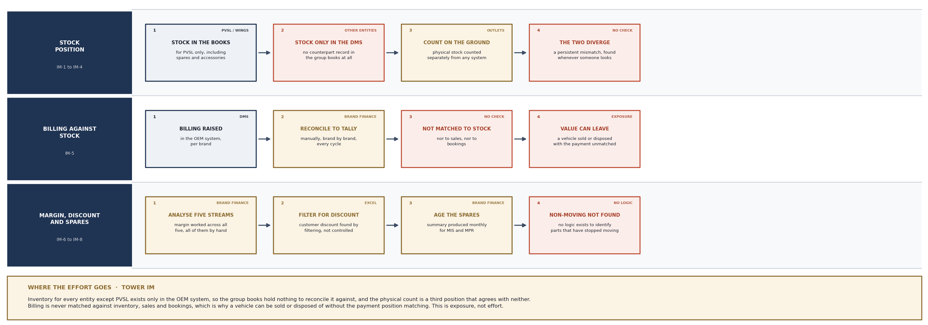
Current Process | Tower IM · Inventory and Margin

Slide 27
Mindmap Digital | Finance Consolidation Platform
Process 5 | Three-Way Inventory
Mmindmapai
Stock is brought in by report extract, so no OEM interface is required.
Physical, DMS and book positions are compared on one basis, continuously.
Positions
Variance
3
Ranked
Inventory on the Platform
Inventory on the Platform
Stock Extracted per Brand
Counts Captured
1
Extract DMS stock
• DMS stock extracted for each brand
• By report extract where no interface exists
• Brings stock in without needing an API
• Runs on the standard ingestion cadence
• Outlets upload the physical count
• Or through a count application at the outlet
• Gives the third leg a system record
• The count stops living outside the platform
2
Capture the counts
3
Resolve to masters
One Comparable Basis
Continuous Variance
4
Compute variance
• All three positions resolve to the vehicle master
• Parts resolve to the part and SKU master
• One comparable basis across the three
• Chassis or VIN is the join
• Three-way variance computed continuously
• The mismatch is measured, not discovered
• Billing matched to movement, sales and bookings
• Closes the gap where value currently leaks
5
Match the billing
6
Rank the exceptions
Margin by Vehicle
Discount as Control
• Cost and revenue resolve to vehicle records
• Margin by vehicle, location and variant
• Across five streams, where cost is carried
• Answers what the current process cannot
• Discount derived per transaction
• Tested against authority thresholds
• Spares aging computed from movement history
• Non-moving parts flagged as a control

Slide 28
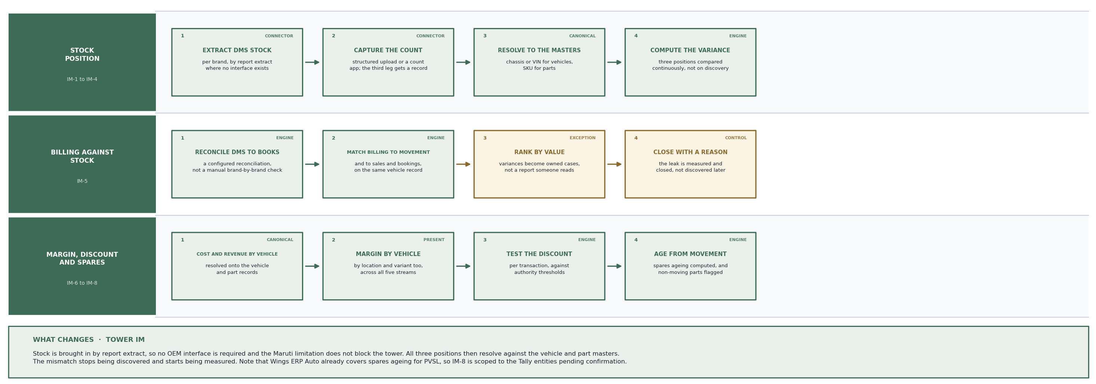
Target Process | Tower IM · Inventory and Margin

Slide 29
Mindmap Digital | Finance Consolidation Platform
Process 6 | Intercompany and RPT
Mmindmapai
Related-party transactions are checked one company against the other.
The board limit has no running total, so a breach surfaces after the fact.
Limit Track
Breach
None
After
Intercompany Today
Intercompany Today
Transactions Across Group
One at a Time Checking
1
Sell and service
• Vehicles sold and serviced between companies
• Ordinary course of business
• Inter-bank transactions reconciled by hand
• Volume accumulates through the year
• A transaction in one company checked in the other
• One transaction at a time
• No flag identifies a related party
• The population feeds elimination manually
2
Check the other side
3
Reconcile by hand
The Board Limit
No Projection
4
Limit set annually
• A related-party limit is fixed for the year
• Set once, annually
• No running total is kept against it
• Consumption is not tracked month on month
• No projection to year end is produced
• The trajectory is not visible
• The breach surfaces after it has occurred
• Approval or ratification is then sought
5
Usage untracked
6
Breach found after
Allocation Formula Drift
What It Costs
• A corporate charge formula set at year start
• Charges allocated month on month by hand
• The basis shifts as hiring and costs change
• Drift is invisible until it has occurred
• Reconciliation performed transaction by transaction
• Board approvals sought reactively
• An entity within limit can breach the next quarter
• Elimination effort carried into the close

Slide 30
Mindmap Digital | Finance Consolidation Platform
Process 6 | Limits Tracked Live
Mmindmapai
A related-party flag on the counterparty master makes the population self-identifying.
Consumption is accumulated against the limit and projected to year end.
Position
Alerts
Live
Before
Intercompany on the Platform
Intercompany on the Platform
Related-party Flag
Automatic Matching
1
Flag on the master
• Group companies flagged on the counterparty master
• Related-party transactions identify themselves
• No manual designation required
• The flag drives every downstream rule
• Both sides matched as a configured reconciliation
• Removes transaction by transaction checking
• Unmatched items raised with a proposed cause
• Investigation becomes targeted
2
Match both sides
3
Accumulate usage
Consumption Accumulated
Full-year Projection
4
Project to year end
• The board limit held as a parameter
• Held against each counterparty relationship
• Consumption accumulated continuously
• A live position, not a year-end discovery
• Consumption pro-rated to a full-year view
• The trajectory is visible, not just the balance
• Alerts fire at configurable thresholds
• Ratification is avoided rather than managed
5
Alert before breach
6
Feed the board pack
Allocation Recalculated
Drift Measured
• The formula held as a versioned parameter object
• Recalculated each period from current cost data
• Reflects hiring and cost changes as they happen
• The basis is explicit and auditable
• Drift against the approved basis is measured
• The movement itself becomes a reported figure
• Material drift raises a case early
• Board pack carries position and projection

Slide 31
Mindmap Digital | Finance Consolidation Platform
Process 7 | Treasury and ECL
Mmindmapai
Treasury cannot plan because the consolidated fund position does not exist.
Credit-loss provisioning waits on the close and is produced four times a year.
Fund View
ECL Cycle
None
Quarter
Treasury Today
Treasury Today
Payments Run Today
No Consolidated Position
1
Payments execute
• Payments executed through existing channels
• This part works and is not the problem
• The gap sits upstream of execution
• Planning is what has no base
• Planning needs funds, collections and payables
• Consolidated, in one place
• Data sits across 81 books, Wings and the DMS
• No single position at any point in the month
2
Data across 81 books
3
No single position
No Forecast Base
No Due-date Trigger
4
No forecast base
• The payment cycle cannot be forecast
• Working capital cannot be forecast
• Planning runs without a consolidated base
• Decisions are taken on partial views
• No trigger exists for payments falling due
• Due dates tracked outside any system view
• Credit terms are not held centrally
• Nothing routes ahead of the date
5
ECL each quarter
6
Buckets by hand
Credit Loss Quarterly
Manual Bucket Work
• The calculation is completed at quarter end
• Two to three days each time
• Computed from receivables aging history
• No monthly view is produced
• Buckets and knock-offs adjusted by hand
• Manual iteration each quarter
• No scenario view exists
• The position is visible four times a year

Slide 32
Mindmap Digital | Finance Consolidation Platform
Process 7 | Treasury on One Layer
Mmindmapai
The consolidated fund position exists as a by-product of the data layer.
Because it refreshes on the ingestion cadence, it is current rather than month-end.
Fund View
ECL Cycle
Live
Monthly
Treasury on the Platform
Treasury on the Platform
One Fund Position
Refreshed on Cadence
1
One data layer
• Funds, collections and payables in one layer
• Resolved against the canonical spine
• The view exists without a separate build
• Available at any point in the month
• The layer refreshes on the ingestion schedule
• A current position rather than a closing one
• Consolidation is a layer, not a report
• Treasury improves as the close does
2
Refresh on cadence
3
Funds and dues shown
Payables Due Computed
Due-date Alerts
4
Compute due dates
• Payments falling due computed from credit terms
• Terms held on the counterparty master
• The trigger the sponsor asked for
• Applies across entities and branches
• Alerts route to treasury ahead of the date
• Owned, aged and closed with a reason
• Planning becomes forward-looking
• Working capital can be forecast
5
Alert ahead of date
6
Model ECL scenarios
Credit Loss Monthly
Scenarios on Screen
• Receivables aging maintained continuously
• No wait for the close to compute
• Credit loss computed monthly
• From four views a year to twelve
• The provisioning matrix held as buckets and rates
• Configurable, explicit and versioned
• Bucket and knock-off scenarios modelled on screen
• Replaces manual adjustment with a controlled view

Slide 33
Mindmap Digital | Finance Consolidation Platform
Process 8 | Controls and Assurance
Mmindmapai
Controls are tested by hand against policy documents that differ by company.
Nothing is configured in a system, so no variation is reported automatically.
Configured
Testing
None
Manual
Controls Today
Controls Today
IFC Performed In-house
Controls Tested by Hand
1
IFC across the group
• IFC covers the holding company and the others
• And the branches beneath them
• Performed in-house by a dedicated team
• Separate from internal audit
• Each control tested manually
• Sample based rather than full population
• Repeated each testing cycle
• Coverage depends on available effort
2
Test the controls
3
Test access rights
Access Rights Tested
Nothing Configured
4
No system limits
• Violations tested manually
• Access-rights violations tested manually
• No system holds the expected state
• Findings depend on who looks
• No controls configured in any system
• No delegations of authority configured
• No SOP limits configured
• Nothing reports a variation automatically
5
No auto variation
6
Audit sits apart
Audit and IFC Apart
No Ledger Scrutiny
• Internal audit reporting is not connected to IFC
• Audit planning and coverage sit apart
• Findings are held in separate places
• No shared view of exposure
• No process exists for ledger scrutiny today
• Recurring error patterns live in experience
• Nothing is recorded as a reusable master
• Detection does not improve with use

Slide 34
Mindmap Digital | Finance Consolidation Platform
Process 8 | Continuous Assurance
Mmindmapai
Controls, delegations and SOP limits are configured once as a control library.
Every control is then tested continuously against canonical data.
Coverage
Findings
Full
Managed
Assurance on the Platform
Assurance on the Platform
Control Library
Full Population Testing
1
Configure the library
• Controls configured as a library
• Delegations of authority held alongside
• SOP limits held as parameters
• The rule base becomes an asset, not documents
• Every control tested against canonical data
• Continuously rather than in cycles
• From sample testing to full population
• Coverage no longer depends on effort
2
Test continuously
3
Raise variations
Variations as Cases
One Shared Case Store
4
Share with audit
• Each variation becomes a case
• Tagged to its control and risk category
• Owned, aged and closed with a reason
• The exception report the sponsor described
• Internal audit and IFC work from one store
• Audit planning and coverage in one view
• Findings visible to both functions
• Gaps seen before an external auditor raises them
5
Run findings master
6
Improve with use
Ledger Scrutiny Agent
The Dependency
• A findings master records recurring error patterns
• Run across the general ledger at full population
• Matches raised with the evidence behind them
• Confirmed findings feed back into the master
• This depends on a standardised policy set
• Documents differ from company to company
• Roughly 80 percent common, 20 percent variable
• The engine can be built before the library exists

Slide 35
Mindmap Digital | Finance Consolidation Platform
Process 9 | Group MIS
Mmindmapai
Data arrives from many people in many formats and is assembled by hand.
Nothing validates the source data, and no forward view is produced.
Formats
Forecast
Many
None
Group MIS Today
Group MIS Today
Inputs from Many People
Assembled by Hand
1
Collect the inputs
• Data arrives from multiple contributors
• In multiple formats
• No standard input format is defined
• Collection precedes any analysis
• Inputs consolidated manually in Excel
• Rebuilt from the submitted files each cycle
• Effort scales with the number of contributors
• No reuse between cycles
2
Assemble in Excel
3
Build the pack
Packs Rebuilt Each Cycle
No Source Validation
4
No data check
• PowerPoint packs produced for investors
• And for debt reporting
• Rebuilt rather than generated
• Formatting effort repeated every time
• No trigger validates the source data
• Errors can reach the pack unchallenged
• Detection depends on someone noticing
• An oversight risk sits in the process
5
Backward looking
6
Rebuild next cycle
No Predictive View
What It Costs
• No forward view is produced
• No predictive analysis is available
• Reporting is backward-looking
• Questions about trajectory go unanswered
• Assembly effort repeated every cycle
• Format variety absorbed manually
• No drill-back from a pack figure to source
• The pack is only as good as the inputs

Slide 36
Mindmap Digital | Finance Consolidation Platform
Process 9 | MIS Generated
Mmindmapai
The pack is built from the consolidated layer, not from submitted files.
Anomaly checks run on the underlying data before the pack is generated.
Pack
Forecast
Auto
Included
Group MIS on the Platform
Group MIS on the Platform
Built from One Layer
Anomaly Checks First
1
Build from the layer
• The pack is generated from the canonical layer
• Not assembled from submitted files
• Format variety is removed at source
• Contributors stop being the bottleneck
• Checks run on the underlying data
• Before the pack is generated
• The oversight risk is met where it originates
• Not after publication
2
Run anomaly checks
3
Raise the issues
Issues Raised Early
Commentary Drafted
4
Draft commentary
• Source-data anomalies raised as cases
• Owned and cleared before publication
• Errors are caught, not discovered later
• The pack goes out on checked data
• MIS commentary drafted by the Narrative Agent
• Reviewed and approved by finance
• Drafting rather than composition
• Anomalies flagged before the pack is built
5
Export the pack
6
Add the forecast
Export on Demand
Forecasts Added
• Exports to PowerPoint, PDF and Excel
• Produced on demand rather than rebuilt
• Every figure traces back to source
• Investor and debt packs share one basis
• Forecasts produced from canonical time series
• The forward view is added to the pack
• Trajectory reported alongside position
• Reporting stops being purely backward-looking

Slide 37
Mindmap Digital | Finance Consolidation Platform
Process 10 | Procurement
Mmindmapai
Odoo carries the whole procurement and vendor management cycle.
It connects to nothing in the accounting layer.
System
Link
Odoo
None
Procurement Today
Procurement Today
Vendor Registration
Requests for Quotation
1
Vendors register
• Vendors register on the Odoo platform
• Vendor master maintained there
• Separate from the counterparty master in books
• One vendor can carry two identities
• RFQs issued from Odoo
• Responses collected in the same platform
• The full cycle runs there
• No visibility from the accounting side
2
Issue the RFQ
3
Run reverse bidding
Reverse Bidding
Vendor Finalised
4
Finalise the vendor
• Reverse bidding cycles run in Odoo
• Price discovery handled in the platform
• Award decisions recorded there
• The outcome does not reach the books
• The vendor is finalised in Odoo
• Purchase orders raised from the platform
• Goods receipts recorded there
• Invoices are booked separately in accounting
5
Manage post-award
6
No accounting link
Post-award Management
No Link to Accounting
• The vendor management cycle runs post-award
• Performance and compliance tracked in Odoo
• Held apart from payment history
• Two records of the same relationship
• No connection exists to the accounting layer
• Procurement and accounting hold separate records
• Three-way matching is not possible
• Payables aging cannot be derived

Slide 38
Mindmap Digital | Finance Consolidation Platform
Process 10 | Procure to Pay Linked
Mmindmapai
The procurement process in Odoo is not disturbed in any way.
A connector creates the first link between procurement and the books.
Identity
Matching
One
3-way
Procurement on the Platform
Procurement on the Platform
Odoo Runs Unchanged
Data Extracted
1
Odoo unchanged
• Registration, RFQ and reverse bidding unchanged
• Award runs exactly as it does today
• The procurement process is not disturbed
• Nothing is migrated out of Odoo
• Vendor, RFQ and purchase order data extracted
• On the standard ingestion cadence
• Held as received in the landing store
• The first link between the two worlds
2
Extract the data
3
Resolve identity
One Vendor Identity
Three-way Matching
4
Match PO, GRN, invoice
• Vendors resolve to the counterparty master
• The same master the books use
• One vendor identity across both systems
• Identity Resolution proposes, a person confirms
• Purchase order matched to goods receipt
• And to the vendor invoice
• Three-way match where receipts sit in Odoo
• Tolerances configured, not coded
5
Compute aging
6
Raise exceptions
Payables Aging
Exceptions Raised
• Aging computed from matched invoices and terms
• Supplies the payables position treasury lacks
• Feeds the fund planning view directly
• Available at any point in the month
• Unmatched items raised as cases
• Out-of-tolerance items raised alongside
• Owned, aged and closed with a reason
• Control over the procure-to-pay chain

Slide 39



































AI and ML
Cloud
Automation
Diverse Domain, Consulting and AI Engineering Strength
Full-stack AI engineering across multiple technology pillars
Product Engineering
ISVs and Specialist capabilities

Slide 40
Take the first step to super power your finance operations.
www.mindmapdigital.ai
saurabh@mindmapdigital.ai
+91 72594 05111
USA | UAE | India | Singapore | UK | Netherlands
This communication is being sent by the offices of MindMap Digital Private Limited and is privileged, confidential and is directed to and for the use of the addressee only. If this message reaches anyone other than the intended recipient, we request the reader not to reproduce, copy, disseminate, or in any manner distribute it.

